Slide 1
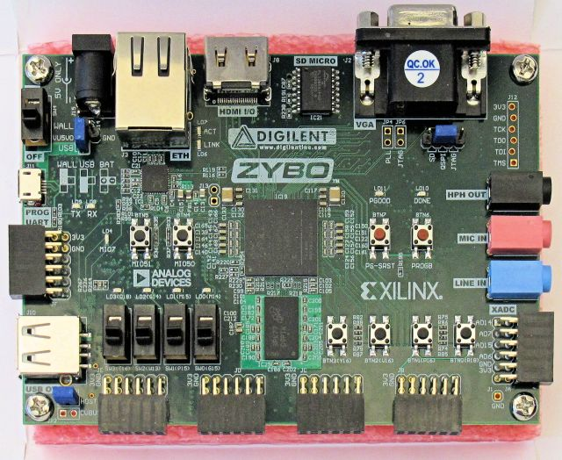
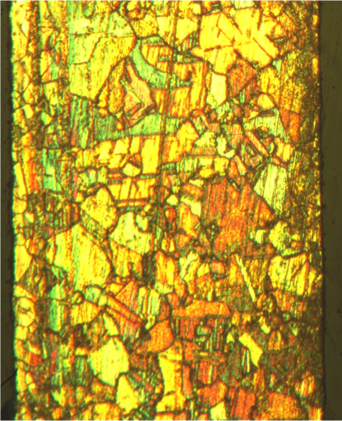
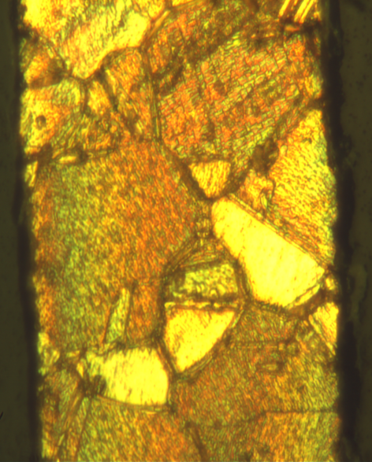
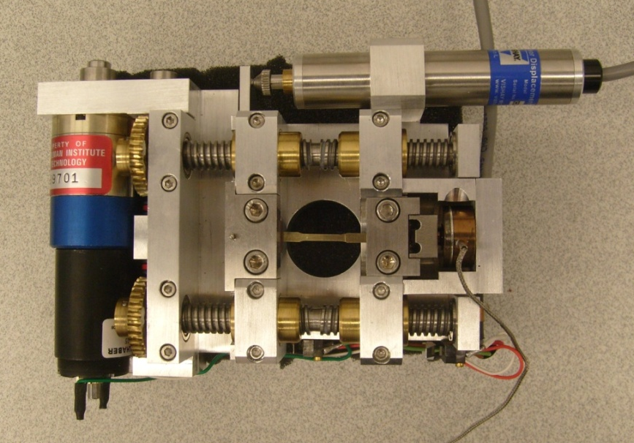
Artificial Neural Network Implemented on an FPGA
Joseph Doherty
Robert Fendricks
Ian Kowalski Dr. Song
ECE Department
Objectives
- Implement an Artifcial Neural Network (ANN) onto a Zybo FPGA board
- Compare runtime and scaling of a hardware ANN to a software ANN
Measurement techniques:
Speed comparisons :
There are several methods available to us to compare the runtimes of the hardware and software artificial neural networks. We can compare the total number of microseconds
Grain Size Measurement:
After treating the metals, sacrificial metal specimens were etched and polished in order
to view their microstructure under a microscope(following ASTM-standards E3 and
E407). The Circular Intercept Method was used to measure the average number of
grains and grain size for each metal specimen as detailed in ASTM-standard E112.
Results
Conclusions and Future Work
It is found that a power hardening model can be used to model both the macroscale and microscale tensile behavior of brass sheet specimens. Future work is planned to develop scaling factors to account for size effects due to miniaturization and expand research to high-strength materials such as stainless steel and titanium alloys.
References
Hosfard, W.F., Caddell, R.M., 2007, Metal Forming, Mechanics and Metallurgy 3rd Ed., Cambridge University Press, New York, NY, pp. 32-34. ASTM E112-96 (Reapproved 2004), Standard Test Methods for Determining Average Grain Size
ASTM E3-01, Standard Guide for Preparation of Metallographic Specimens
ASTM E407-07, Standard Practice for Microetching Metals and Alloys
ASTM E8-04, Standard Test Methods for Tension Testing of Metallic Materials
Abstract
Artificial neural networks description and goal
Artificial neural networks are an artificial intelligence method for reaching decisions on data. They are known for their relative ease of parallelization, allowing for increases in speed. Our project is to create an artificial neural network in hardware and compare its speed, effectiveness , and scalability to a software neural network.
Comparison of true stress vs. true strain plots and power hardening models for macroscale tensile test (0.508 mm thick, left) and microscale tensile test (0.102 mm thick, right)
Microtensile Tests
0.508 mm | n | K (MPa)
Unheated (Trial 1) | 0.025 | 495
Unheated (Trial 2) | 0.0504 | 476
Unheated (Trial 3) | 0.142 | 852
T = 450 C | 0.2344 | 759
T = 550 C | 0.241 | 740
T = 575 C | 0.2679 | 751
T = 610 C | 0.2972 | 771
0.203 mm | n | K (MPa)
Unheated (Trial 1) | 0.0454 | 141
Unheated (Trial 2) | 0.0511 | 194
T = 450 C | 0.3115 | 435
T = 550 C | 0.339 | 469
T = 575 C | 0.3643 | 496
T = 610 C | 0.3672 | 499
0.102 mm | n | K (MPa)
Unheated (Trial 1) | 0.0514 | 135
Unheated (Trial 2) | 0.0551 | 125
T = 450 C | 0.2883 | 137
T = 550 C | 0.3295 | 228
T = 575 C | 0.3538 | 224
T = 610 C | 0.4442 | 255
Experimental Methods
Macroscale Tensile Test:
The mechanical properties of macroscale tension specimens were
measured following ASTM-standard E8. An ATS 1620-CC Universal
Testing Machine was used to apply a constant displacement-rate of
9.68 mm/min across the macroscale specimens and measure the resulting
load, while an EIR LE-01 Laser Extensometer was used to measure the
elongation of the reduced section of the tensile specimens. The resulting
force and elongation data was then used to generate a true stress vs. true
strain curve for each metal specimen.
Microscale Tensile Test:
A microscale tensile test experiment was created using a stepper motor to
induce a displacement-rate of 9.68 mm/min on the specimens. The
displacement was then measured using a linear variable displacement
transducer (LVDT). A load cell was used to measure the resulting force.
Macrotensile Tests
0.508 mm | n | K (MPa)
Untreated (Trial 1) | 0.0127 | 452
Untreated (Trial 2) | 0.0925 | 554
Untreated (Trial 3) | 0.063 | 522
T = 450 C | 0.3527 | 615
T = 550 C | 0.4272 | 691
T = 575 C | 0.4465 | 696
T = 610 C | 0.5039 | 679
Experimentally determined parameters of Strength Coefficient, K and Work Hardening Exponent, for microtensile tests (top) and macrotensile tests (bottom)
ZYBO FPGA development board
Acknowledgements
The authors would like to thank:
ArcelorMittal for funding this project
XXX for their contribution to project
YYY for their contribution to the project
5 µm
Microstructure of polished and etched Brass specimens heat-treated for 1.5 hours at 450°C (0.203 mm thick, left) and 610°C (0.102 mm, right)
Microscale tensile testing machine

